Slide 1
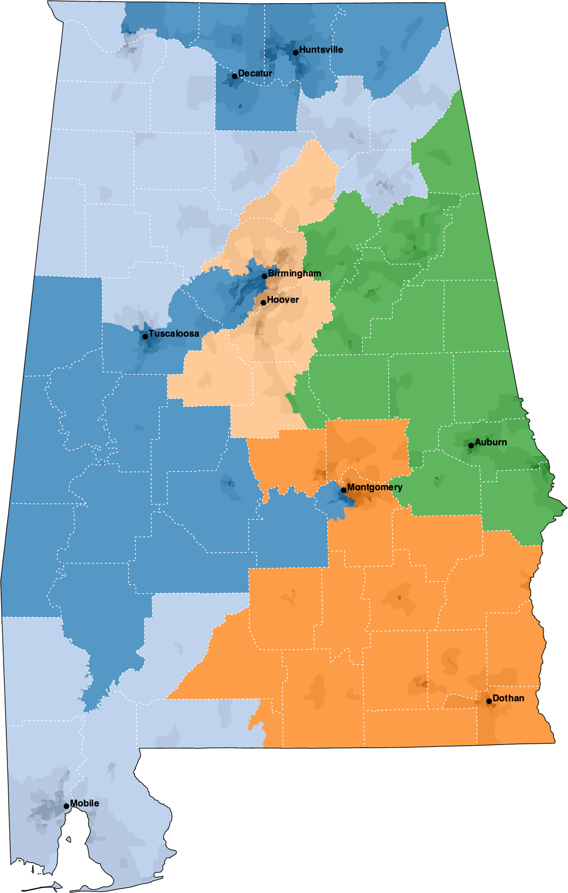
2021 Final Congressional

Slide 2
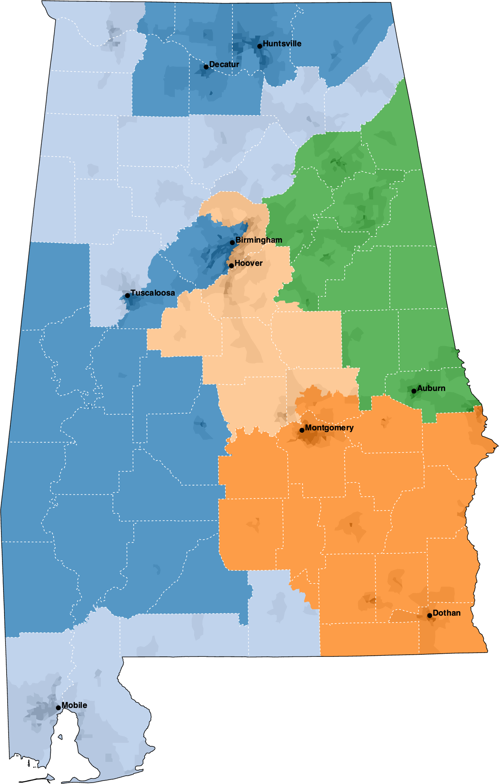
Livingston 3 (2023 Final)

Slide 3
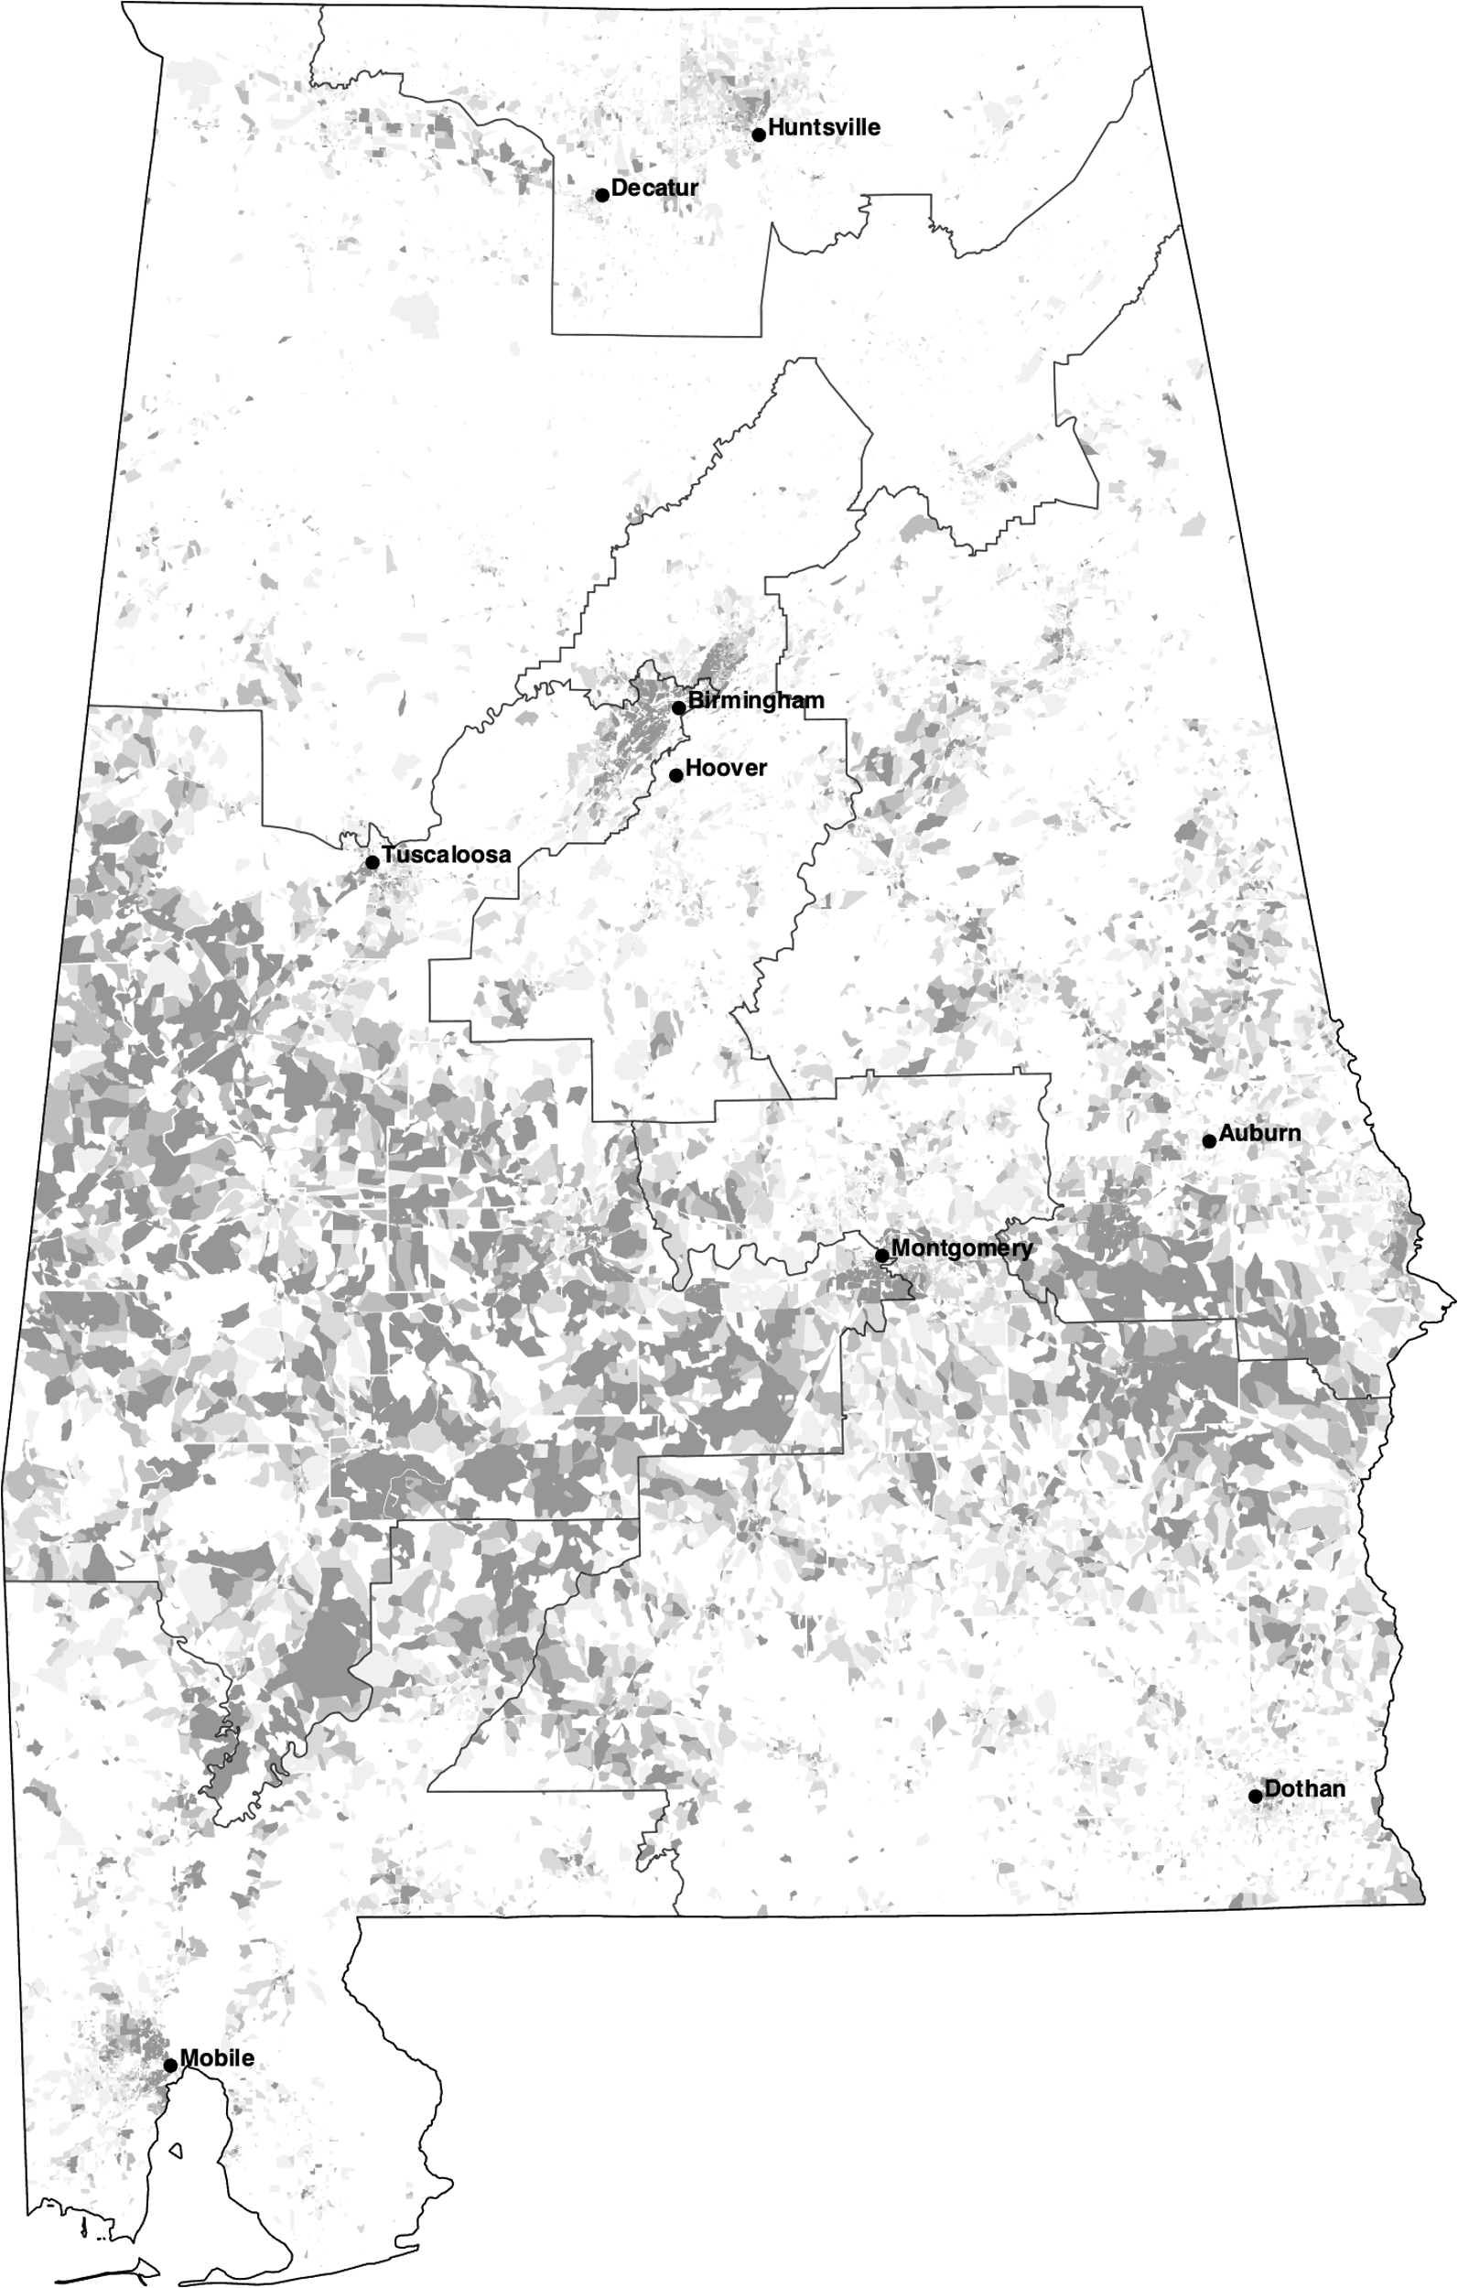
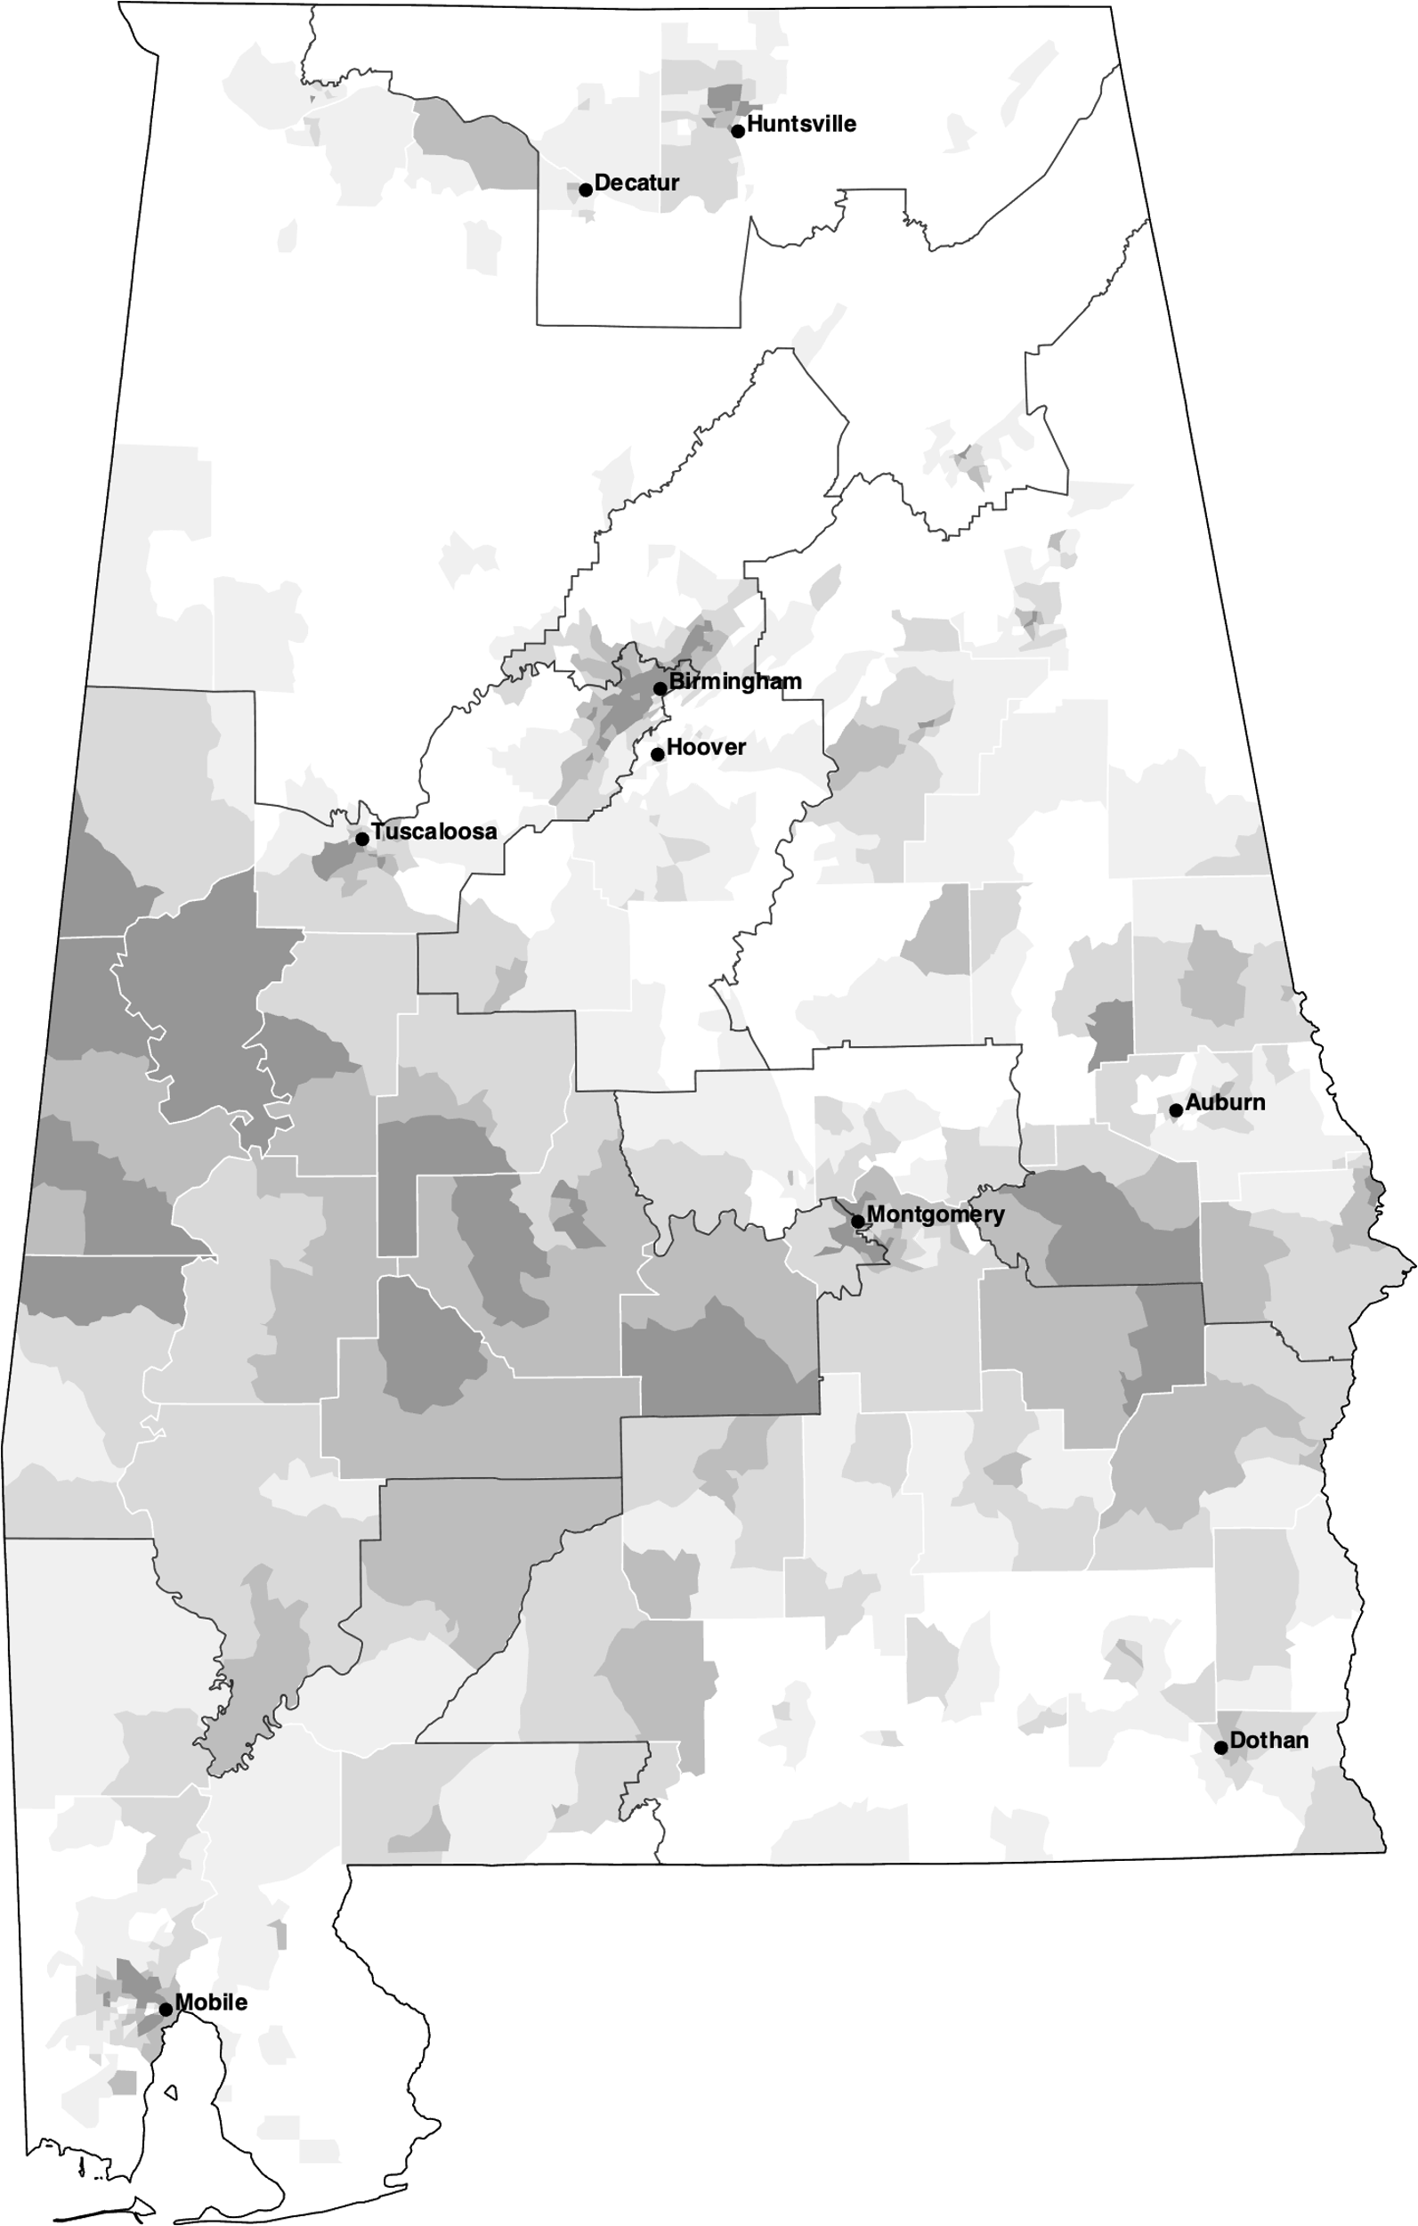
2021 Final Congressional Percent Black of total population
blocks
tracts

Slide 4


Livingston3 (2023) Percent Black of total population
blocks
tracts

